Slide 1
Vocabulary Review
Strategies for vocabulary instruction
in content areas

Slide 2
SELECTION OF VOCABULARY WORDS
How many words per week do you think students should be required to learn?
You will probably be able to thoroughly teach only a few new words per week— perhaps 8 or 10!!
Remember-those would include words in ALL subject areas—not just reading!!

Slide 3
SELECTION OF VOCABULARY WORDS
What words should you teach?
Focus on three types of words:
  Important- integral for understanding a concept or the book
  Useful- words that might be used again and again across contexts and in conversation
  Difficult- multiple meaning and idiomatic expressions- These can be especially difficult. Content related words (i.e. photosynthesis, map key, scale, etc.)

Slide 4
Tiered Words
Tier 1-requires no instruction, concepts that are already familiar (i.e. baby, cry, house, etc.)
Tier 2-More sophisticated synonyms for words many children know—can be used “daily.” Students encounter these words in texts, less often in spoken language (i.e. infant, bawled, residence, etc.)
Tier 3-Content/Domain specific-words used in content areas like science, social studies, history, and or math classes (i.e. volcano, atmosphere, cumulus cloud, Emancipation Proclamation, Pythagorean theorem)

Slide 5
Avoid
Teaching or assigning words from textbooks just because they are highlighted in some way (italicized, bold face print, etc.).
Teaching or assigning words just because they appear in a list at the end of a text chapter.
Assigning words the teacher cannot define.
Assigning large quantities of words.
Assigning words that students will rarely encounter again.

Slide 6
An example of explicit instruction:
1. Introduce the word “fancy.”
Read the word to the students
“Say the word fancy with me. Look at the little word “fan” and then the ending “cy”. The c makes an s sound and they y makes a long e sound in this word”
Say it in a sentence.
  “I like to dress up in my fancy clothes when I go to a party.”

Slide 7
Tip 2
  Provide a Student Friendly Definition
  “Fancy means to go above the normal. It is more than your ordinary, every day stuff.”
  Student-Friendly Explanation (Beck, McKeown, & Kucan, 2003)
      Uses known words.
      Is easy to understand.

Slide 8
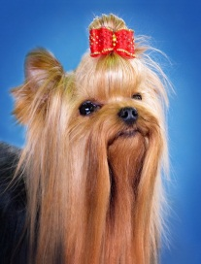


Tip 3
3. Illustrate the word with examples or pictures.
Here are some pictures of some fancy things.
“Let’s take a look. There are some ladies in fancy dresses. The dresses are very formal; there are not the kinds of dresses we wear everyday to school or work. The dogs are fancy with their hats and bows. We even see a fancy table setting.”

Slide 9
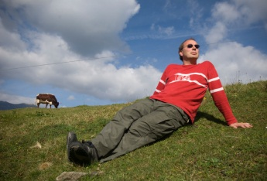
Tip 4
4. Check for understanding.
Look at this picture of these men. Are they fancy? Why or why not?
What kinds of things do you wear when you are being fancy? Or what do you see your mom or dad wear when they dress in fancy clothes?

Slide 10
Provide multiple exposures
-Review the words after you finish the book.
-Match the words to the corresponding pictures/concepts in the book.
-Use the word in other contexts/conversations during the day.
-It is also helpful to require students to actively work with words, use in sentences, redefine, classify, etc.

Slide 11
Another Vocabulary Review Idea
The students all have a page with the vocabulary pictures. The teacher asks questions and the students point to pictures or chorally respond to questions.
Examples:
“Touch the picture that shows a ‘troop’.”
“Touch the picture that shows that someone is ‘victorious’. What does it mean to be ‘victorious’?”
“Touch the picture that shows someone is happy about something they did. What is the vocabulary word?”
“Touch a picture that shows someone has done something that is hard. What is the vocabulary word?”
“Touch the picture that shows ‘farewell’. What does ‘farewell’ mean?

Slide 12
Try a Vocabulary Overview Guide
Together, review “tier 2 words”, their meaning, what they may look like.
Have students read a book, paragraph, chapter, etc.
As they read, remind them to attend/look for tier 2 words.
After reading, distribute the vocabulary overview guide for students to complete.
Upon completion, have students share their tier 2 words identified from their reading.
Be sure to refer and use tier 2 words in your daily instruction or display on a word wall if these are important for student understanding.

Slide 13
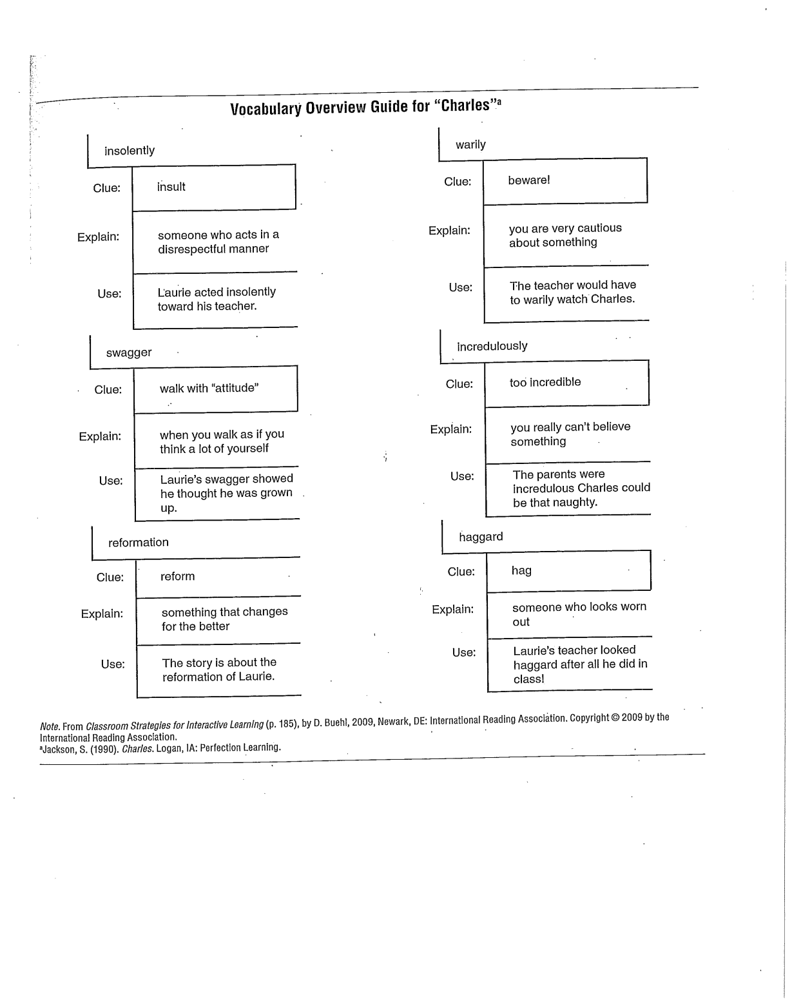
Vocabulary Overview Guide

Slide 14
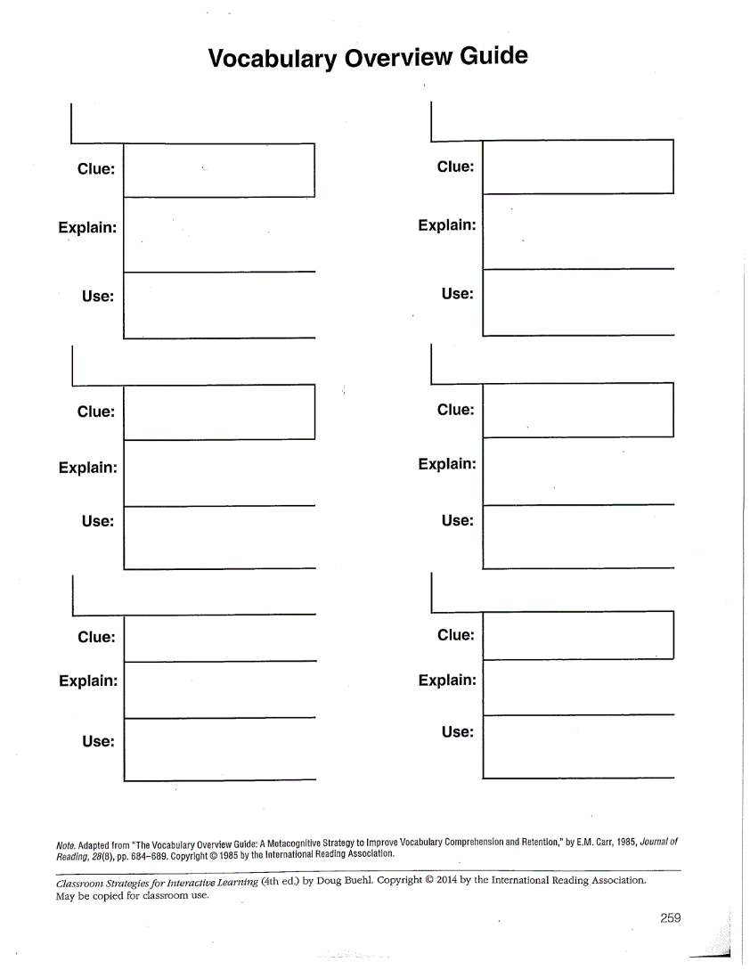
Vocabulary Overview Guide Blank

Slide 15
Vary the Types of Independent Vocabulary Practice Activities!
Example of Independent Activities:
Day 1: Write new vocabulary words on vocabulary cards to add to a vocabulary ring or vocabulary card file.
Day 2: Write student-friendly definitions on back of vocabulary cards.
Day 3: Complete Word Diagram or Four Square Page with 4 new vocabulary words.
Day 4: Complete Word Diagram or Four Square Page with 4 new vocabulary words.
Day 5: Partner up and test each other on vocabulary definitions (using vocabulary cards students take turns saying the word and the other student gives the student-friendly definition -- or -- one student gives the student-friendly definition and the other student says the word).

Slide 16
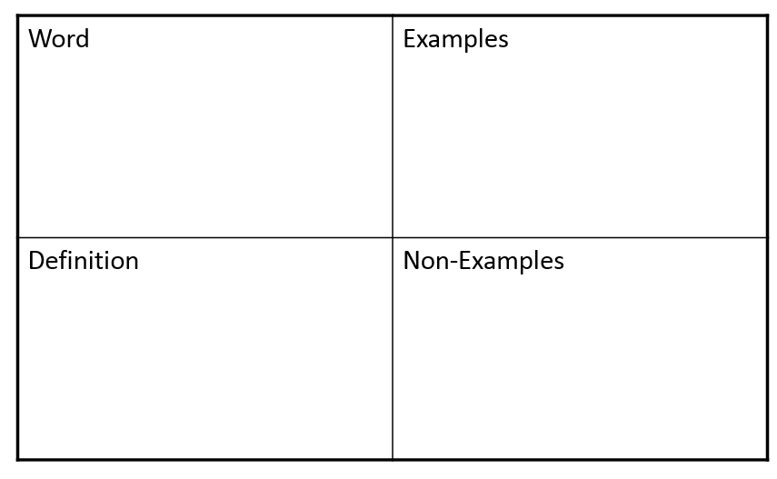
Four-Square Vocabulary

Slide 17
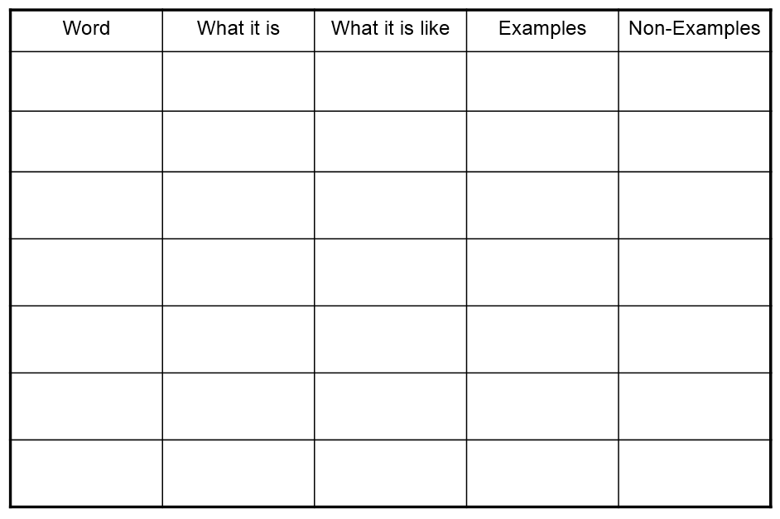
Word Diagrams

Slide 18
Using Structural Analysis in Vocabulary Development
Many words in the English language are made up of words parts called prefixes, roots, and suffixes.
  These word parts have specific meanings that, when added together, can help you determine the meaning of the entire word.
    Example: The students thought the book was incomprehensible.
      in = not
      Comprehen = to understand
      ible = able to do something; also changes this word from verb to adjective
      incomprehensible = not able to understand

Slide 19
Structural Analysis
In most cases, a word is built upon at least one root.
Words can have more than one prefix, root, or suffix.
  Two or more roots – geo/logy: earth/study of
  Two prefixes – in/sub/ordination: not/under/order
  Two suffixes – beauti/ful/ly: beauty/full of- noun to
  adjective/ly- adjective to adverb
Words do not always have a prefix and a suffix.
  Some words have neither a prefix or a suffix – read
  Others have a suffix but no prefix – read/ing
  Others have a prefix but no suffix – pre/read

Slide 20
Structural Analysis
The spelling of roots may change as they are combined with suffixes – Root: terr/terre = territory
Different prefixes, roots, or suffixes may have the same meaning:
bi-, di-, duo- all mean two
Sometimes you may identify a group of letters as a prefix or root but find that it does not carry the meaning of that prefix or root:
Ex. The letters mis in the word missile are part of the root and are not the prefix mis- which means “wrong; bad”
  Prefix, Suffix and Root tables

Slide 21
Word Family Tree
Try a word family tree for structural analysis and vocabulary development (see example).
Choose one content specific word for students to process the meaning and structural analysis.

Slide 22
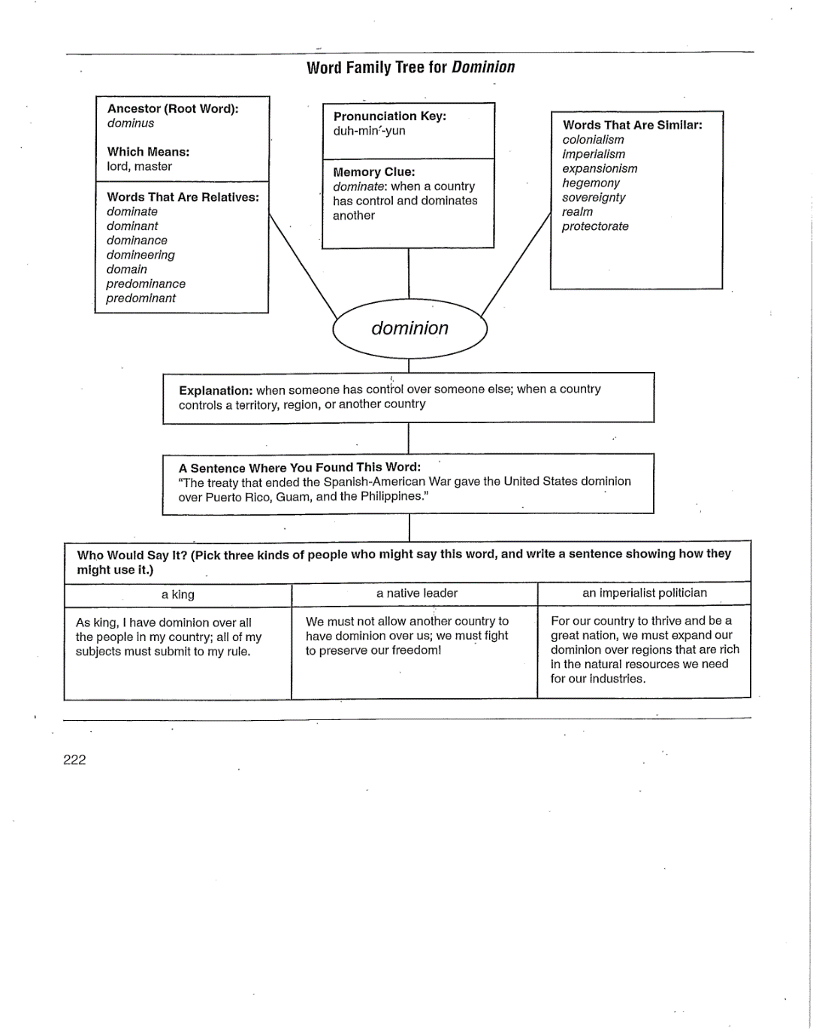
Word Family Tree

Slide 23
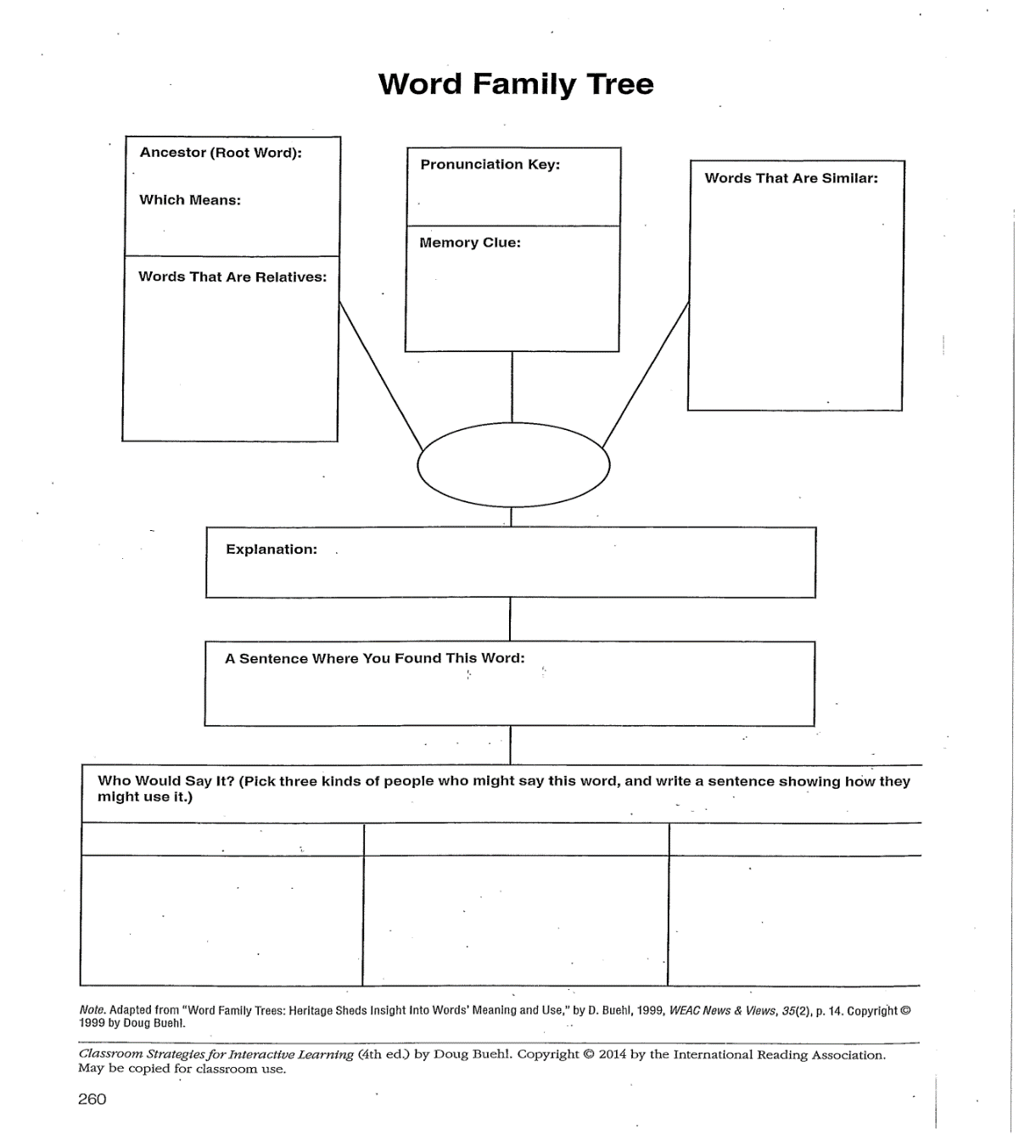
Word Family Tree Blank

Slide 24
References
Armbruster, B. B., Lehr, F., & Osborn, J. (2001). Put reading first: The research building blocks for teaching children to read. Retrieved from Put reading first
Beck, I.L., McKeown, M.G., & Kucan, L. (2014). Bringing words to life: Robust vocabulary instruction. (2nd ed.). New York, NY: Guilford.
Buehl, D. (2014). Classroom strategies for interactive learning. (4th ed.). Newark, DE: International Reading Association.
Trelease, J. (2013). The read-aloud handbook. New York, NY: Penguin.
Yaeger, J.A. (2014). “Wisconsin foundations of reading study guide.” Retrieved from jenniferyaeger.weebly.com

